Slide 1
Searching and Indexing
Indexing
Indexing is the initial part of all search applications.
Its goal is to process the original data into a highly efficient cross-reference lookup in order to facilitate rapid searching.
The job is simple when the content is already textual in nature and its location is known.

Slide 2
Indexing
Steps:
acquiring the content.
This process gathers and scopes the content that needs to be indexed.
build documents
The raw content that needs to be indexed has to be translated into the units (usually called documents) used by the search application.
document analysis
The textual fields in a document cannot be indexed directly. Rather, the text has to be broken into a series of individual atomic elements called tokens.
This happens during the document analysis step. Each token corresponds roughly to a word in the language, and the analyzer determines how the textual fields in the document are divided into a series of tokens.
index the document
The final step is to index the document. During the indexing step, the document is added to the index.

Slide 3
Lucene
Lucene is a free, open source project implemented in Java.
licensed under Apache Software Foundation.
Lucene itself is a single JAR (Java Archive) file, less than 1 MB in size, and with no dependencies, and integrates into the simplest Java stand-alone console program as well as the most sophisticated enterprise application.
Rich and powerful full-text search library.
Lucene to provide full-text indexing across both database objects and documents in various formats (Microsoft Office documents, PDF, HTML, text, and so on).
supporting full-text search using Lucene requires two steps:
creating a lucence index
creating a lucence index on the documents and/or database objects.
Parsing looking up
parsing the user query and looking up the prebuilt index to answer the query.

Slide 4
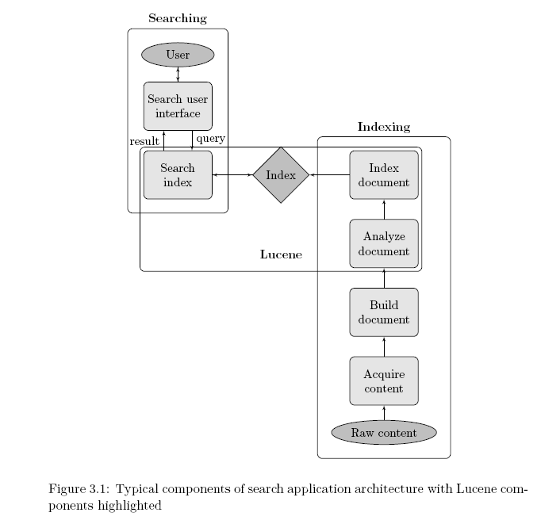
Architecture

Slide 5
Query: not
c:\docs\einstein.txt:
The important thing is not to
stop questioning.
String comparison slow!
Solution:
Inverted index
c:\docs\shakespeare.txt:
To be or not to be.

Slide 6
Inverted index
Query: not
be
important
is
not
or
questioning
stop
to
the
thing
1
0
0
0 1
1
0
0
0 1
0
0
c:\docs\einstein.txt:
The important thing is not to
stop questioning.
0
c:\docs\shakespeare.txt:
To be or not to be.
1
Document IDs

Slide 7
Inverted index
Query: ”not to”
be
important
is
not
or
questioning
stop
to
the
thing
1
0
0
0 1
1
0
0
0 1
0
0
c:\docs\einstein.txt:
The important thing is not to
stop questioning.
0
0 1 2 3 4 5
6 7
c:\docs\shakespeare.txt:
To be or not to be.
1
0 1 2 3 4 5
Document IDs

Slide 8
Inverted index
Query: ”not to”
be
important
is
not
or
questioning
stop
to
the
thing
1
0
0
0
1
0
0
0
0
0
1
1
3
4
2
7
6
5
0
2
5
c:\docs\einstein.txt:
The important thing is not to
stop questioning.
0
0 1 2 3 4 5
1
6 7
c:\docs\shakespeare.txt:
To be or not to be.
1
1
0 4
0 1 2 3 4 5
Document IDs
Positions

Slide 9
Inverted index with Payloads
1
0
0
0
1
0
0
0
0
0
1
1
3
4
2
7
6
5
0
2
5
be
important
is
not
or
questioning
stop
to
the
thing
c:\docs\einstein.txt:
The important thing is not to
stop questioning.
0
0 1 2 3 4 5
1
6 7
c:\docs\shakespeare.txt:
To be or not to be.
1
1
0
4
0 1 2 3 4 5
Document IDs
Positions

Slide 10
Creating an Index (IndexWriter Class)
The first step in implementing full-text searching with Lucene is to build an index.
To create an index, the first thing that need to do is to create an IndexWriter object.
The IndexWriter object is used to create the index and to add new index entries (i.e., Documents) to this index. You can create an IndexWriter as follows
IndexWriter indexWriter = new IndexWriter("index-directory", new StandardAnalyzer(), true);

Slide 11
Parsing the Documents (Analyzer Class)
The job of Analyzer is to "parse" each field of your data into indexable "tokens" or keywords.
Several types of analyzers are provided out of the box. Table 1 shows some of the more interesting ones.
StandardAnalyzer
A sophisticated general-purpose analyzer.
WhitespaceAnalyzer
A very simple analyzer that just separates tokens using white space.
StopAnalyzer
Removes common English words that are not usually useful for indexing.
SnowballAnalyzer
An interesting experimental analyzer that works on word roots (a search on rain should also return entries with raining, rained, and so on).

Slide 12
Adding a Document/object to Index (Document Class)
.To index an object, we use the Lucene Document class, to which we add the fields that you want indexed.
Document doc = new Document();
doc.add(new Field("description", hotel.getDescription(), Field.Store.YES, Field.Index.TOKENIZED));

Slide 13
Elasticsearch (NO-SQL)
What is ElasticSearch ?
● Open Source (No-sql DB)
● Distributed (cloud friendly)
● Highly-available
● Designed to speak JSON (JSON in, JSON out)

Slide 14
Highly available
● For each index you can specify:
● Number of shards
– Each index has fixed number of shards
● Number of replicas
– Each shard can have 0-many replicas, can be changed dynamically

Slide 15
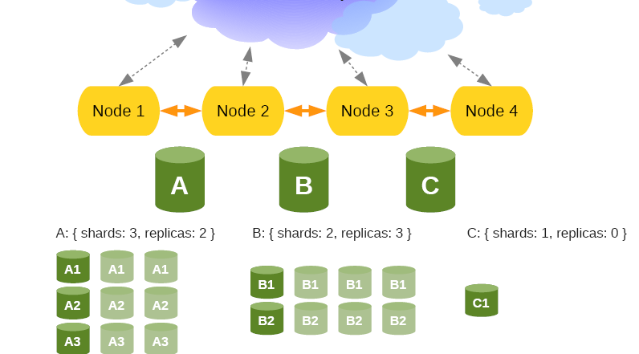

Slide 16
Admin API
● Indices
– Status
– CRUD operation
– Mapping, Open/Close, Update settings
– Flush, Refresh, Snapshot, Optimize
● Cluster
– Health
– State
– Node Info and stats
– Shutdown

Slide 17
Rich query API
● There is rich Query DSL for search, includes:
● Queries
– Boolean, Term, Filtered, MatchAll, ...
● Filters
– And/Or/Not, Boolean, Missing, Exists, ...
● Sort
-order:asc, order:desc
● Facets
Facets allows to provide aggregated data for
the search request
–Terms, Term, Terms_stat, Statistical,….

Slide 18
Scripting support
● There is a support for using scripting languages
● mvel (default)
● JS
● Groovy
● Python

Slide 19
ES_Query syntax
{
“fields”:[“name”,”Id”]
}
-------------------------------------------
{
“from”:0,
“size”:100,
“fields”:[“name”,”Id”]
}

Slide 20
ES_Query syntax
{
“fields”:[“name”,”Id”]
“query”:{
}
}
-------------------------------------------
{“from”:0, “size”:100, “fields”:[“name”,”Id”],
“query”:{
“filtered”:{
“query”:{
“match_all”:{}
},
“filter”:{
“terms”:{
“name”:[“ABC”,”XYZ”]
}
}
}
}
}

Slide 21
Filter_syntax
{“filter”:”terms”:{
“name”:[“ABC”,”XYZ”]
}
-----------------------
{
“filter”:
{
“range”:
{
“from”:0,
“to”:10
}
}
}

Slide 22
Facets_Syntax
{
“facets”:{
“facet_name”:{
“terms”:{
“name”:[”ABC”, ”XYZ”]
}
}
}
}

Slide 23
Facets_Syntax
{
“facets”:{
“facet_name”:{
“term_stats”:{
“key_field”:”name”
“value_field”:”salary”
}
}
}
}

Slide 24
Assignment
Indexing and Searching with LUCENE

